Slide 1
ChatApp - A Flutter Application

Slide 2
Project Overview
Purpose:
A mobile application for real-time messaging and communication.
Key Features:
One-on-one and group chat functionality.
Real-time message updates with notifications.
Media sharing (images, videos, and documents).
User authentication and profile management.
Secure end-to-end encryption for privacy.
Technology Stack:
Flutter Framework for cross-platform development.
Dart Programming Language for efficient performance.
Firebase Firestore for real-time database and messaging.
Firebase Authentication for user login and registration.

Slide 3
App Architecture
Screens in the Chat App
1. Splash Screen (WelcomeScreen)
Attractive gradient background.
Welcome message or app logo animation.
Redirects to login or chat screen based on authentication status.
2. Chat List Screen (ChatListScreen)
Displays a list of recent conversations.
Shows user avatars, names, and message previews.
Includes online/offline status indicators.
3. Chat Screen (ChatScreen)
Real-time messaging interface.
Supports text, images, videos, and voice messages.
Typing indicators and read receipts.
4. User Profile Screen (ProfileScreen)
Displays user details and profile picture.
Allows editing of name, status, and profile image.
Logout option for secure access.

Slide 4
Key Features
Gradient Background (Blue to White) – Provides a visually appealing UI.
Real-time Messaging – Instantly send and receive messages.
Typing Indicators & Read Receipts – Know when the other person is typing or has seen your message.
Engaging Call-to-Action – Smooth onboarding experience with a friendly welcome screen.
Modern UI Design – Clean interface with soft shadows, rounded corners, and smooth animations.

Slide 5
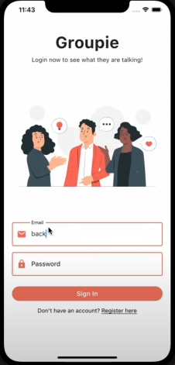

Slide 6
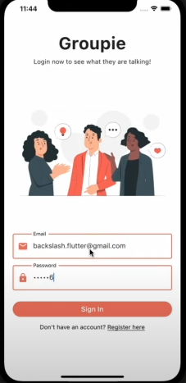

Slide 7
Key Features
Data Handling in the Chat App:
Fetches Messages from Firebase Firestore – Ensures real-time updates.
Displays Chats in a User-Friendly Format – Messages appear in a structured bubble layout.
Handles:
Loading State – Shows a spinner while fetching messages.
Error State – Displays an error message if data retrieval fails.
Empty State – Provides a placeholder when no messages are available.
Responsive UI for Images & Media – Supports sending and viewing multimedia files seamlessly.

Slide 8
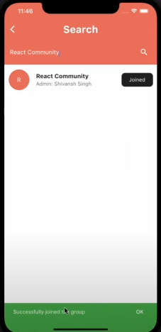

Slide 9
Key Features
Detailed Chat View:
Full Conversation Display – Shows entire chat history between users.
User Metadata – Displays sender name, timestamp, and message status (sent, delivered, read).
Readable Chat Layout – Messages appear in a clear, structured format with alternating chat bubbles.
Media Support – Allows viewing shared images, videos, and links.
"Reply" and "React" Features (Future Enhancements) – Enables users to respond to specific messages with replies or reactions.

Slide 10
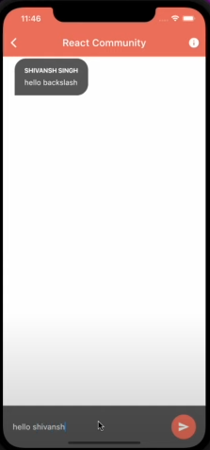

Slide 11
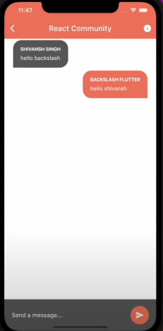

Slide 12
Technical Implementation
Technical Implementation for Chat App
State Management: Uses setState for basic UI updates and Provider or Riverpod for scalable state management.
Real-time Communication: Implements Firebase Firestore or WebSockets for instant message syncing.
API Integration: Uses Firebase Authentication for user login and Firestore database for storing messages.
UI Components:
Custom chat bubbles with sender/receiver differentiation.
Adaptive layouts for different screen sizes.
Input fields with emoji and file attachment support.
Navigation: Implements Navigator.push() and Navigator.pop() for screen transitions between chats, contacts, and settings.

